Slide 1
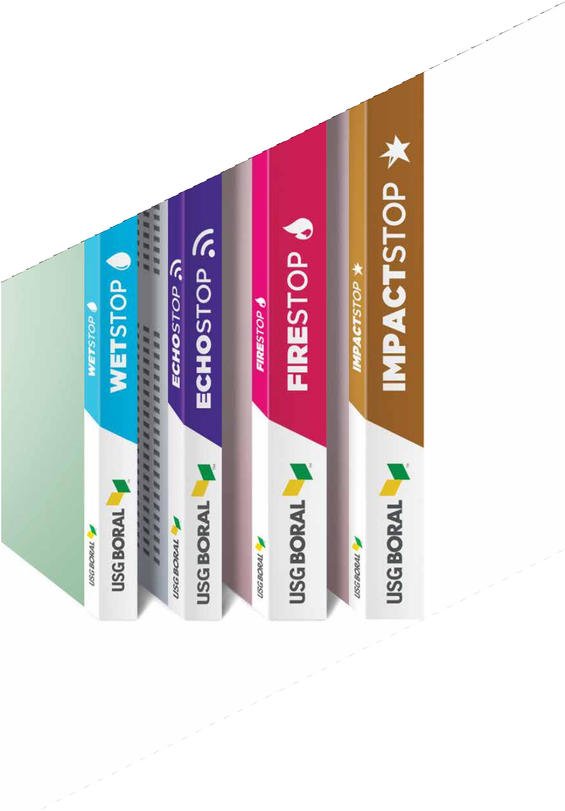

taikongbot TECHNICAL GYPSUM BOARD PORTFOLIO
taikong board
taikong board
moinstureban
fireban
moistureban
waterban
fireban
waterban
taikongbot.com
© 2019 taikongbot. All rights reserved.

Slide 2
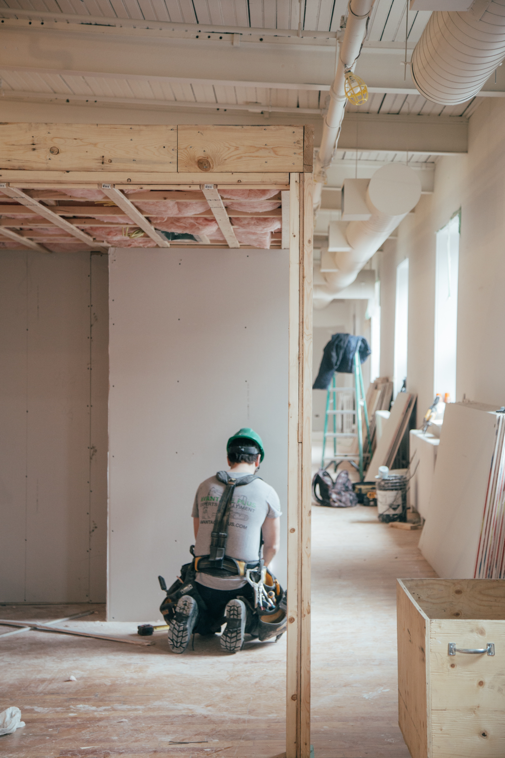
Technical Gypsum Board

Slide 3
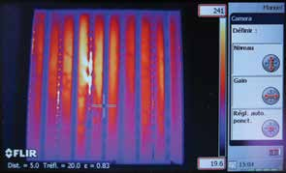
EXPERTISE IN DESIGN AND CONSTRUCTION
Our Commitment to Your Safety
taikongbot places safety in the highest regard. We strive to ensure safety for all our customers, from those who specify our products to those who build with our products, as well as those who live and work in environments where our products are assured. The design and installation of our fire-rated systems are all in accordance with our manufacturer’s instructions, and are strictly installed in accordance to relevant test standards.
The Standard ISO 834 Cellulosic Time-Temperature Curve
1400
1200
945
1006
1049
1082
1110
1000
842
Temperature 800
(°C)
600
400
576
200
349
0
20
30
60
90
Time (min)
120
150
180
Our certified fire-rated partition are exposed to a fire curve that is modelled after a ventilated controlled fire, with the temperature increasing to 842°C after 30 minutes.
Fire Regulation
The major concern when it comes to safeguarding lives against a catastrophic fire is the level of fire protection and the effectiveness of these protective measures.
Traditionally, designers follow a set of prescriptive Fire Code requirements in applying the required fire protection for a building. However, in recent years, performance-based fire safety engineering has gained popularity among designers, especially for big and complex buildings where more a cost-centric approach is required.
The table below shows the objectives and means of performance-based fire safety engineering:
Objectives Means
To keep people safe
Appropriate building design (compartments, smoke extraction, escape routes, ...)
To limit the risks of fire extension and consequences
Classification of construction products and systems
3

Slide 4
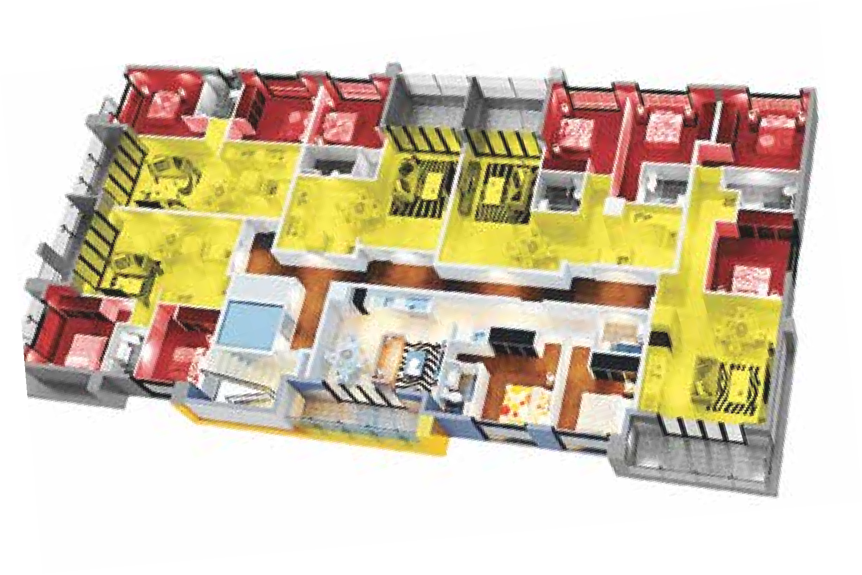

FIRE-RATED PARTITIONS
Technical Gypsum Board
Fire Safety Engineering
taikongbot’s most commonly used fire-rated systems can be easily used in accordance with the performance- based principles of fire safety engineering. Our systems are tested and can be referenced across some of the most prestigious projects world-wide.
taikongbot’s technical gypsum board portfolio can be utilized as shown for a one-stop solution.
taikongbot ImpactStop® for abuse resistance in the corridors
taikongbot 2-hour fire-rated partition
taikongbot WetStopTM for superior water resistance in areas such as bathrooms and kitchens
taikongbot 1-hour fire-rated partition
taikongbot Sheetrock® comfortably on taikongbot single span metal framing
The conceptual fire safety engineering design of a typical floor in an apartment.
taikongbot 1-hour Fire-Rated Partition
taikongbot 2-hour Fire-Rated Partition
16mm taikongbot FireStop®
2 x 12.5mm taikongbot FireStop® (or thicker)
16mm taikongbot FireStop®
Lower fire rating (FRL -/60/60) in non- sleep rooms such as classrooms, offices and common areas.
2 x 12.5mm taikongbot FireStop® (or thicker)
Higher fire rating (FRL -/120/120) in sleeping rooms such as hotels and hospitals.
Refuge Areas/Floors
Fire engineers and designers often put in refuge areas to limit flame and smoke spread to protect lives or critical equipment. The area of refuge is set aside for situations when evacuation may not be possible or is otherwise unsafe.
For example, patients in a hospital may not be able to use a stairwell to exit the building when there is a fire. People can wait in the area of refuge safely until rescued by firefighters or emergency rescue teams. This area may also have the name “area of rescue assistance.”
The fire ratings in these floors are higher than usual and typically incorporate fire-rated ceilings or have fire corridor systems.
Refuge floors shown in red in a high-rise building.

Slide 5
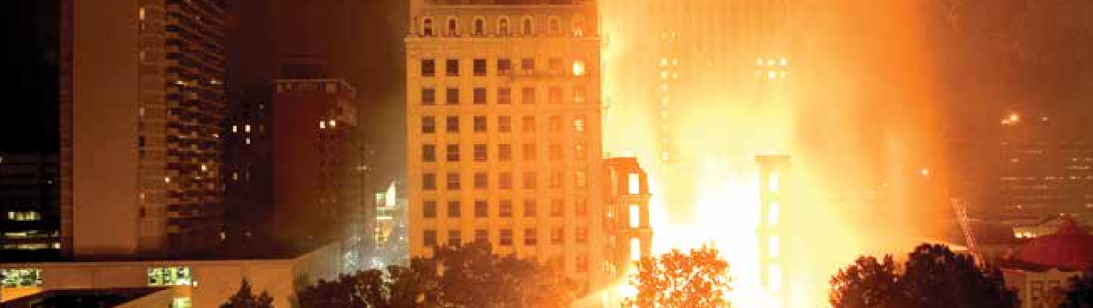
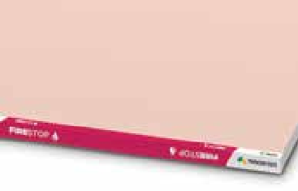
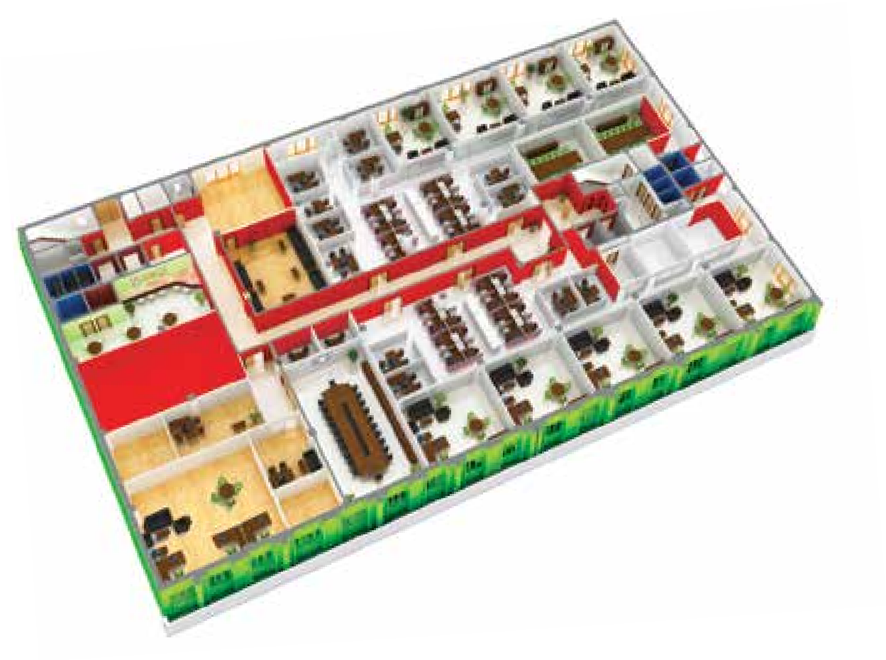

FIRE-RESISTANT GYPSUM BOARD
Protecting What’s Most Valuable to You
Fire racing through a residential complex. Life-threatening events such as this and the catastrophic fire incident at the Grenfell Tower in London continue to challenge and change the way we approach fire safety engineering.
Features and Benefits: Fire-Resistant Gypsum Board
The gypsum that makes the core of taikongbot’s FireStop® Gypsum Board portfolio is specially formulated to resist the dehydration by heat in the event of a fire.
The non-combustible gypsum board core is tested to various standards such as British, American or European standards for the products and systems that provide minimum periods of fire resistance.
taikongbot FireStop® Gypsum Board
Fire Safety
Functionality
Fire escape
Fire-rated partition for corridors as a mode
of escape
Fire-rated ceiling in server rooms
Taikongbot Rated Drywall/Ceiling
taikongbot Securock™ Fire-rated Exterior Wall
Fire compartmentation is a concept where the spread of fire within a building is restricted by partitioning walls or floors with fire resisting walls or ceilings. These partitions can also deter the spread of smoke which allows for a safe mode of escape during an emergency.
Application: Fire Resistance
The concept of fire resistance is the ability of a structure to maintain its structural capability and prevent the spread of flames or heat when exposed to fire conditions.
taikongbot’s fire-rated gypsum board portfolio and systems are tested to:
Non-combustibility, surface- burning characteristics:
BS 476 : Part 4,6 and 7
EN 13501-1 ASTM C1396
System performance for
30 minutes and up to 4 hours:
BS 476 : Part 22
EN 13501-2 ASTM E119
5

Slide 6
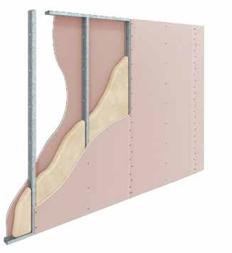
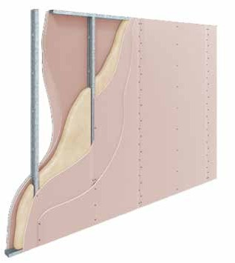
FIRE-RATED SYSTEMS
Technical Gypsum Board
1-hour Fire-Rated Steel Stud - Vertical Fixing
Top track
Do not fasten gypsum board to top and bottom track
C-studs @ 600mm max ctrs
Tape and set joints to external layers only
Acoustic insulation if required
Vertical and horizontal joints to be staggered with adjacent and opposite boards
1 layer of 16mm taikongbot FireStop® of WetStop + FireStopTM on each face
300mm
Fasteners spaced at 300mm in field and at 200mm on the edges of the gypsum board
Bottom track
200mm
Fasteners 10-16mm from edge of sheet
2-hour Fire-Rated Steel Stud - Vertical Fixing
Top track
60mm nom
Do not fasten gypsum board to top and bottom track
C-studs @ 600mm max ctrs
Tape and set joints to external layers only
Acoustic insulation if required
Vertical and horizontal joints to be staggered with adjacent and opposite boards
Stagger joints in layers
300mm
2 layers of 12.5mm taikongbot FireStop® of WetStop + FireStopTM on each face
Fasteners spaced at 300mm in field and at 200mm on the edges of the gypsum board
200mm
Fasteners 10-16mm from edge of sheet
Bottom track

Slide 7
1-hour Fire-Rated Partition
System No. | Fire-Rating FRL (Test Ref.) | Description and physical data |  |  |  | Acoustic Performance
SS5 | 1 Hour-/60/60* BS 476 EN 13501-2 ASTM E119 Non-load bearing | 16mm taikongbot FireStop® Width 16mm taikongbot FireStop® |  |  |  | STC 43 with insulation (92 CS 55) Ref. Acoustic System ASS3
 |  | Steel Stud Partition - 1 layer 16mm taikongbot FireStop® or WetStop + FireStopTM on each side of 51, 64, 76, 92 and 150mm CS Studs @ 610mm centers max. Caulk all perimeter gaps with taikongbot Fire Sealant. Mass 26/kg/m²
 |  | Limiting Height mm (max) Width Studs Studs BMT 0.25kPa (mm) (mm) (mm)
 |  | 3390 d | 83 | 51 | .50
 |  | 3920 d | 96 | 64 | .50
 |  | 4350 d | 96 | 64 | .75
 |  | 4530 d | 96 | 64 | 1.15
 |  | 4320 d | 108 | 76 | .55
 |  | 5260 d | 108 | 76 | .75
 |  | 5430 d | 108 | 76 | 1.15
 |  | 5210 d | 124 | 92 | .55
 |  | 5730 d | 124 | 92 | .75
 |  | 5940 d | 124 | 92 | 1.15
 |  | 7200 d | 182 | 150 | .75
 |  | 7800 d | 182 | 150 | 1.15
2-hour Fire-Rated Partition
System No. | Fire-Rating FRL (Test Ref.) | Description and physical data |  |  |  | Acoustic Performance
SS2 | 2 Hours-/120/120 BS 476 EN 13501-2 ASTM E119 Non-load bearing | 2 x 12.5mm taikongbot FireStop® (or thicker) Width 2 x 12.5mm taikongbot FireStop® (or thicker) |  |  |  | STC 53 with insulation (92 CS 55) STC 52 with insulation (64 CS 55) Ref. Acoustic System ASS9
 |  | Steel Stud Partition - 2 layers 12.5mm taikongbot FireStop® or WetStop + FireStopTM on each side of 76, 92 and 150mm CS Studs @ 610mm centers max. Caulk all perimeter gaps with taikongbot Fire Sealant. Mass 52/kg/m²
 |  | Limiting Height mm (max) Width Studs Studs BMT 0.25kPa (mm) (mm) (mm)
 |  | 4320 d | 140 | 76 | .55
 |  | 5260 d | 140 | 76 | .75
 |  | 5430 d | 140 | 76 | 1.15
 |  | 5210 d | 156 | 92 | .55
 |  | 5730 d | 156 | 92 | .75
 |  | 5940 d | 156 | 92 | 1.15
 |  | 7200 d | 214 | 150 | .75
 |  | 7800 d | 214 | 150 | 1.15
Limiting Heights shown are the lesser of Fire Height (f) without pressure, and Structural Limiting Height (in a non fire environment) at 0.25kPa governed by Deflection l/240 (d), Strength (s) or End Reaction (r). End reaction refers to the manner in which the stud is retained in the top and bottom track i.e. friction fit or rigidly fixed.
Mid-span nogging is recommended for erection purposes in walls higher than 3600mm.
Use of rock wool is optional for fire-rated partitions shown
7

Slide 8
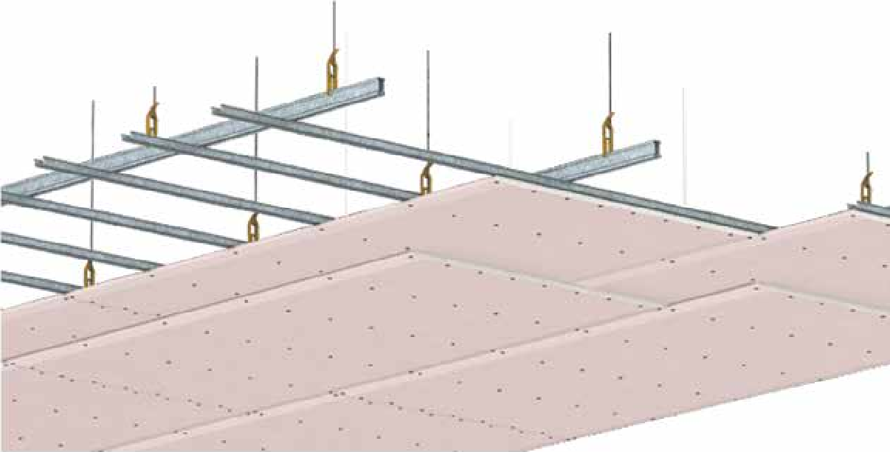
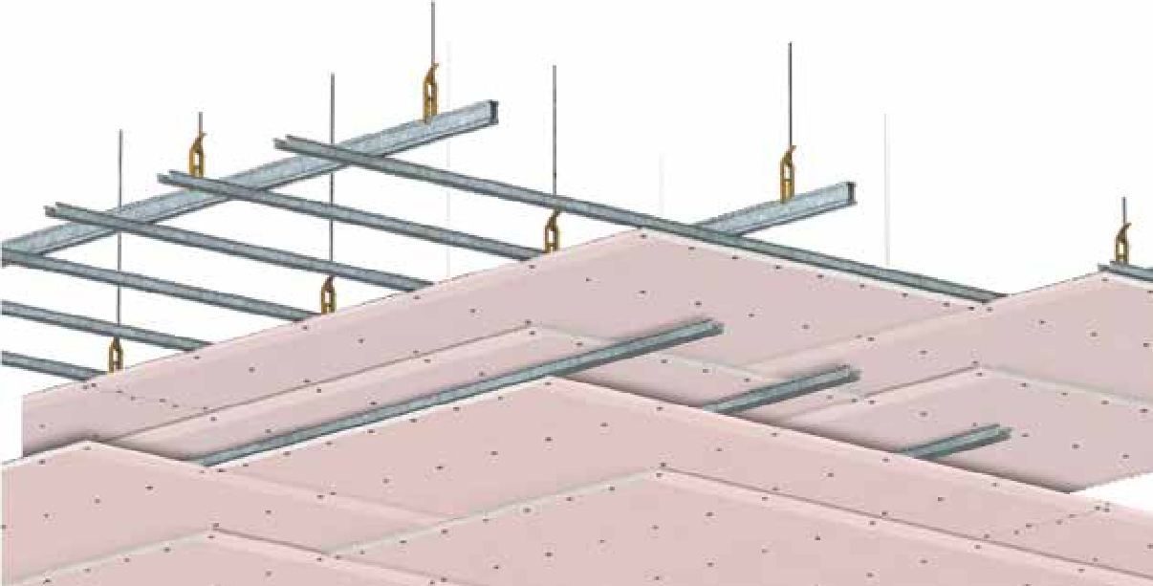
FIRE-RATED SYSTEMS
Technical Gypsum Board
1-hour Fire-Rated Ceiling
taikongbot Suspension Clip (adjustable)
Taikongbot Main Runner @ 1200mm max ctrs
taikongbot Suspension Rods @ 1200mm max ctrs
End joints formed on furring channels, otherwise end joints on first layer must be back-blocked. Where applicable, end joints of second layer should be screw laminated to previous layer @ 200mm max ctrs
taikongbot Joiner Clip
taikongbot Furring Channel @ 600mm max ctrs
150mm
200mm
End joints formed on furring channels, otherwise end joints on first layer must be back-blocked. Where applicable, end joints of second layer should be screw laminated to previous layer @ 200mm max ctrs
Tape and finish face layer only with taikongbot Jointing System
1 or 2 layers of taikongbot
FireStop® fixed transverse to Furring Channels @ 600mm max ctrs
All joints staggered min 200mm
Screw 10mm - 16mm from edges
2-hour Fire-Rated Ceiling
taikongbot Suspension Clip (adjustable)
taikongbot Main Runner @ 1200mm max ctrs
taikongbot Suspension Rods @ 1200mm max ctrs
End joints formed on furring channels, otherwise end joints on first layer must be back-blocked. Where applicable, end joints of second layer should be screw laminated to previous layer @ 200mm max ctrs
taikongbot Joiner Clip
taikongbot Furring Channel @ 600mm max ctrs
200mm
150mm
Gypsum Board fasteners
Tape and finish
4 layers of taikongbot FireStop® (upper 2 layers transverse to roof or floor framing plus lower 2 layers running transverse to upper layers fixed in a secondary system of Furring Channels @ 600mm max ctrs).
All sheets staggered min 200mm between layers
to be 200mm max ctrs in
All joints staggered min 200mm
Screw face layer only 10mm - 16mm with taikongbot
field and 150mm max ctrs
at seet ends and butt joints
(staggered)
from edges Jointing System

Slide 9
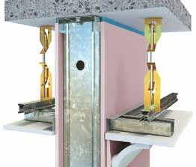


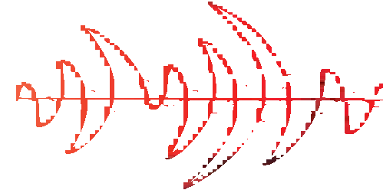



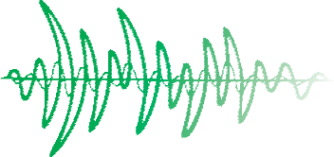









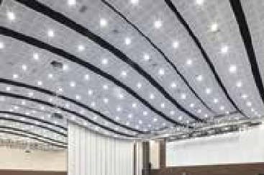


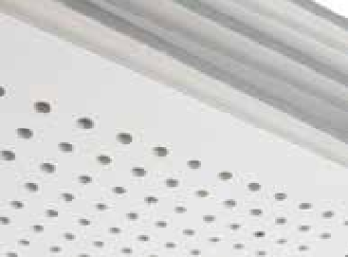
ACOUSTIC GYPSUM BOARD
Acoustics that Enhance the Quality of Life
A Guide to Sound Transmission Class (STC) Values
25 | Normal speech can be heard easily
30 | Loud speech can be heard easily
35 | Loud speech can be heard but comprehension might be compromised
42 | Loud speech can be heard as murmur
45 | Must strain to hear loud speech
48 | Loud speech can be barely be heard
50 | Loud speech cannot be heard
55 | Loud speech and low frequency sound are further reduced
Room 1 Room 2
Acoustic privacy can be enhanced by incorporating special acoustically rated drywall partitions into the design of a layout. The table serves as a guide to sound insulation levels.
Features and Benefits: Acoustic Gypsum Board
Lightweight partition systems, made from acoustically enhanced gypsum boards have consistently proved to be excellent solutions to mask unwanted noise from an adjacent space.
The acoustically engineered systems exceed mass law predictions that demonstrate that adding mass is not the most economical answer to effective sound isolation.
The Gyeongju Hwabaek International Convention Center in South Korea utilizes the taikongbot ArtSoundTM to achieve the desired acoustic performance.
Enhanced Acoustic Functionality Comfort
Aesthetic
Application: Acoustic Design
In recent years, multiple studies have proven that speech intelligibility is recognized as contributing factor in helping students achieve their full potential^{1,2}. Hospitals and health centers also benefit from an acoustically well-designed environment to enhance rest and recovery.
In order to provide the best acoustic performances, taikongbot’s ArtSoundTM Gypsum Board is specially designed to have sound absorption of up to NRC
0.7 as tested according to ASTM 423.
taikongbot EchoStop®/ArtSoundTM Gypsum Board
¹ Bradley, J.S., Oct 1986. Speech Intelligibility Studies in Classrooms
² Masson, F.N, et al, Sept 2016, Intelligibility in a Classroom : Coupling effects between outdoor noise and room acoustic response
9

Slide 10
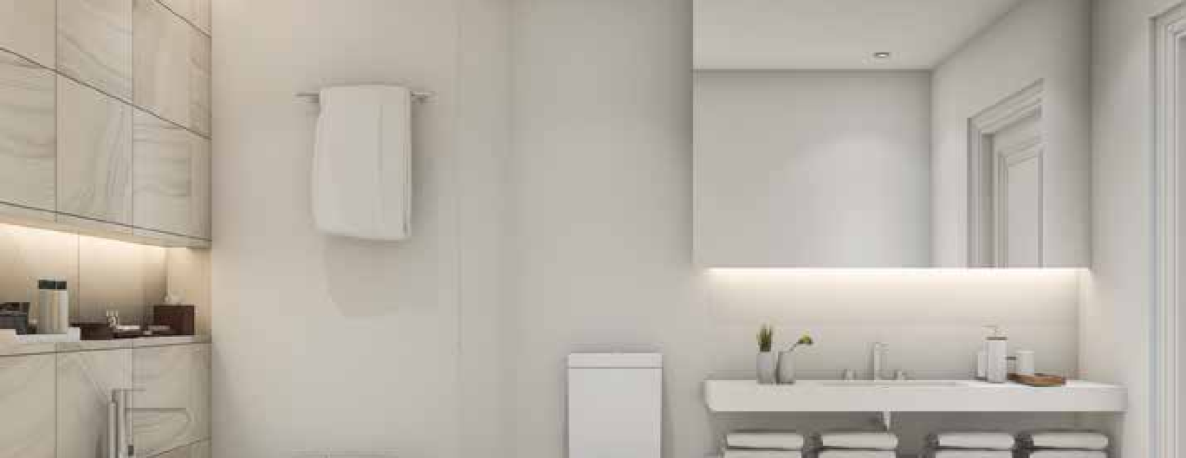


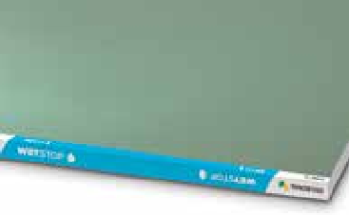
MOISTURE-RESISTANT GYPSUM BOARD
Technical Gypsum Board
Keeping You Dry and Comfortable
Application of the made-for-purpose moisture-resistant gypsum board in a bathroom ensures peace of mind when it comes to performance and comfort.
Features and Benefits: Moisture-Resistant Gypsum Board
taikongbot’s Moisture-Resistant Gypsum Board are manufactured to stringent requirements that repel moisture. The water-resistant core is formulated with water repellent additives and encased in specified moisture-resistant face and back liner papers.
These boards are also produced in fire-rated wet area formulations and form robust wet area systems when installed according to taikongbot Installation Manual. Ceramic tiles and natural marble, weighing up to 32 kg/sqm, may be directly adhered onto the taikongbot WetStopTM Gypsum Board.
Wet area gypsum boards are also available in fire-rated formulation known as taikongbot WetStop + FireStopTM.
Moisture- Resistant
Functionality
Application: Wet Area Design
Most building codes³ dictate that areas within a building, which are exposed to moisture such as laundries, pantries, kitchens, showers and sanitary compartments, should be constructed with building elements that are waterproof or water-resistant. taikongbot’s range of Moisture-Resistant Gypsum Board is designed to perform to these building codes and ensure appropriate protection against dampness.
Taikongbot WetStopTM Gypsum Board
³ AS 3740 : Waterproofing of Wet Areas within Residential Building

Slide 11
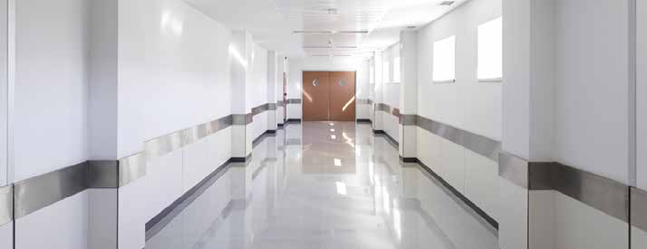
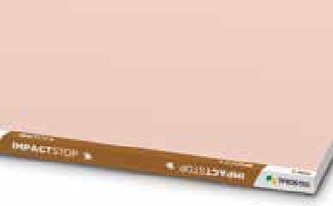


ABUSE-RESISTANT GYPSUM BOARD
Robustness and Extraordinary Lifespan
Some partitions have to be stronger and more durable than others, like this hospital corridor lined with taikongbot’s abuse-resistant gypsum board.
Features and Benefits: Abuse-Resistant Gypsum Board
Impact resistance on walls typically takes into account collisions in the form of soft body, abrasive and hard body under the BS 5234 and ASTM C1629 tests. taikongbot’s MultiStopTM and ImpactStop® Gypsum Board range from
heavy duty systems that not only achieve heavy to severe duty performance,
but can also be engineered to resist damage from door slamming and heavyweight anchorages of wash basins.
taikongbot ImpactStop® Gypsum Board
Abuse- resistant
Functionality
Application: Resisting Crowd Pressure
taikongbot Abuse-Resistant Gypsum Board can be used in areas such as corridors where a solid partition is desired as shown in the table below:
Drywall Performance | Typical Occurrence | Description
Light | Residential spaces | Small chance of accident Persons tend to exercise care
Medium | Business offices | Some chance of accident and misuse Spaces are moderately used Persons exercise some care
Heavy | Industrial areas Light to medium crowd traffic | Some chance of accident and misuse Chance of accident or misuse occuring Area is highly used Persons exercise minimal care
Severe | Heavy industrial areas High traffic public areas | Susceptable to vandalism with high chance of accident and misuse High traffic with space being used extensively by public
11

Slide 12
Australia China India Indonesia Malaysia
Middle East New Zealand Thailand Philippines Singapore South Korea Vietnam

